Slide 1
ECS 251 Project
Local Chat Server
Huanjie Dong
Xiao Liu

Slide 2
Demo

Slide 3
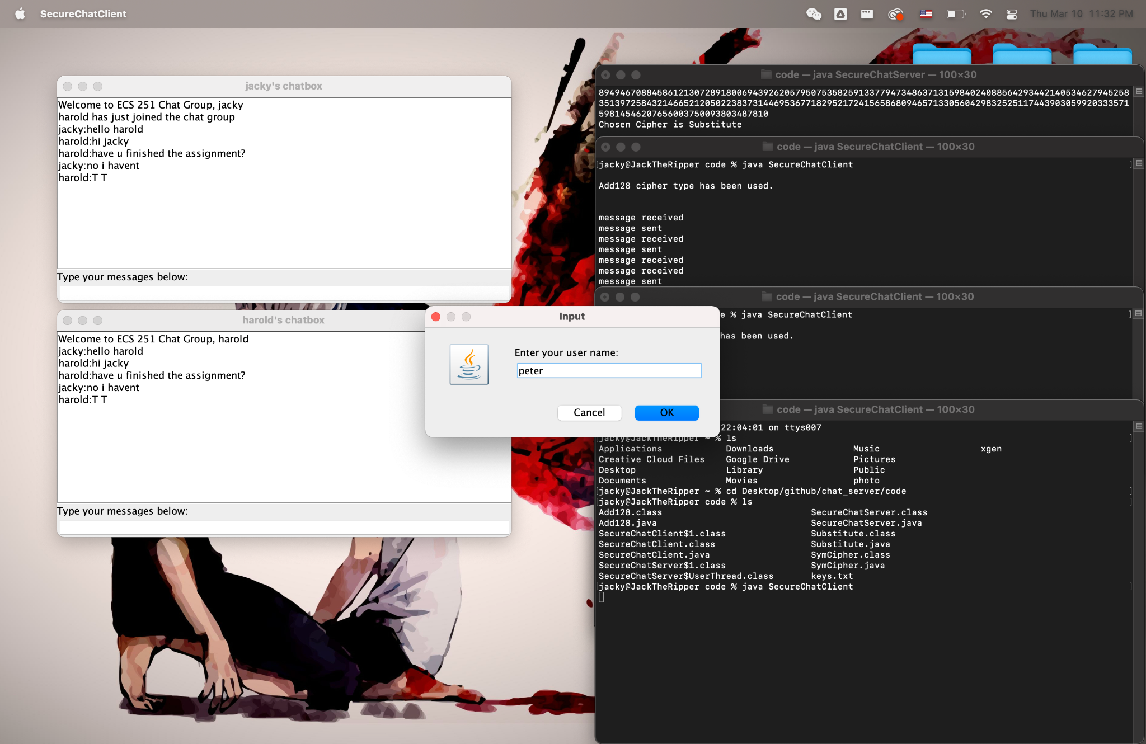
java SecureChatServer
java SecureChatClient
(default max users: 30)
sever: localhost
port: 8888

Slide 4
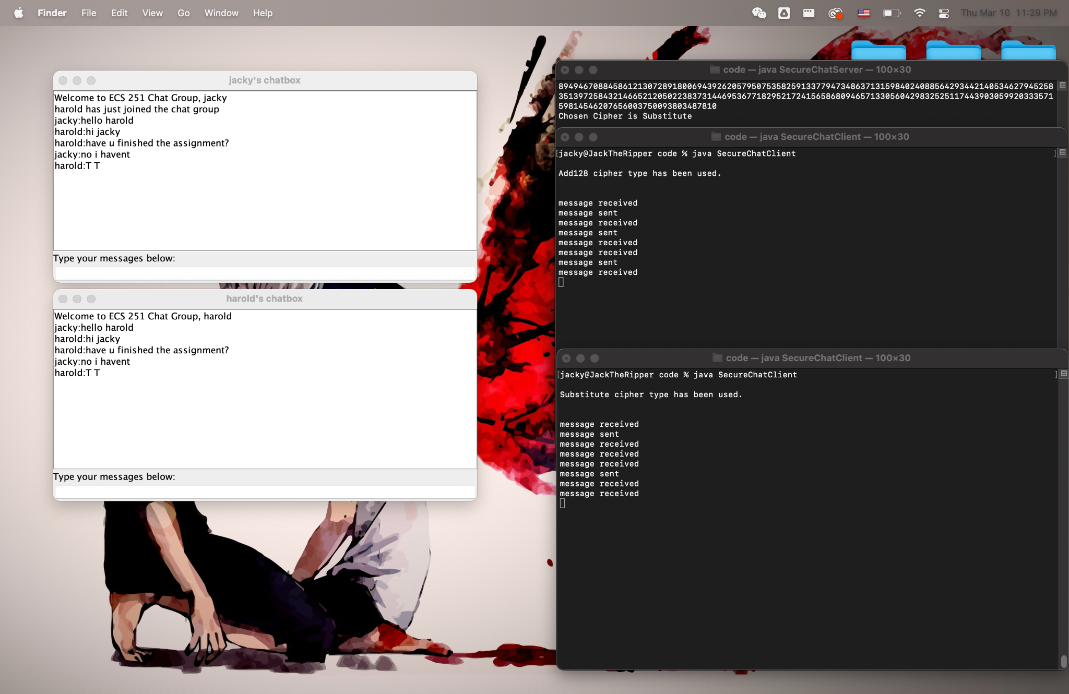

Slide 5
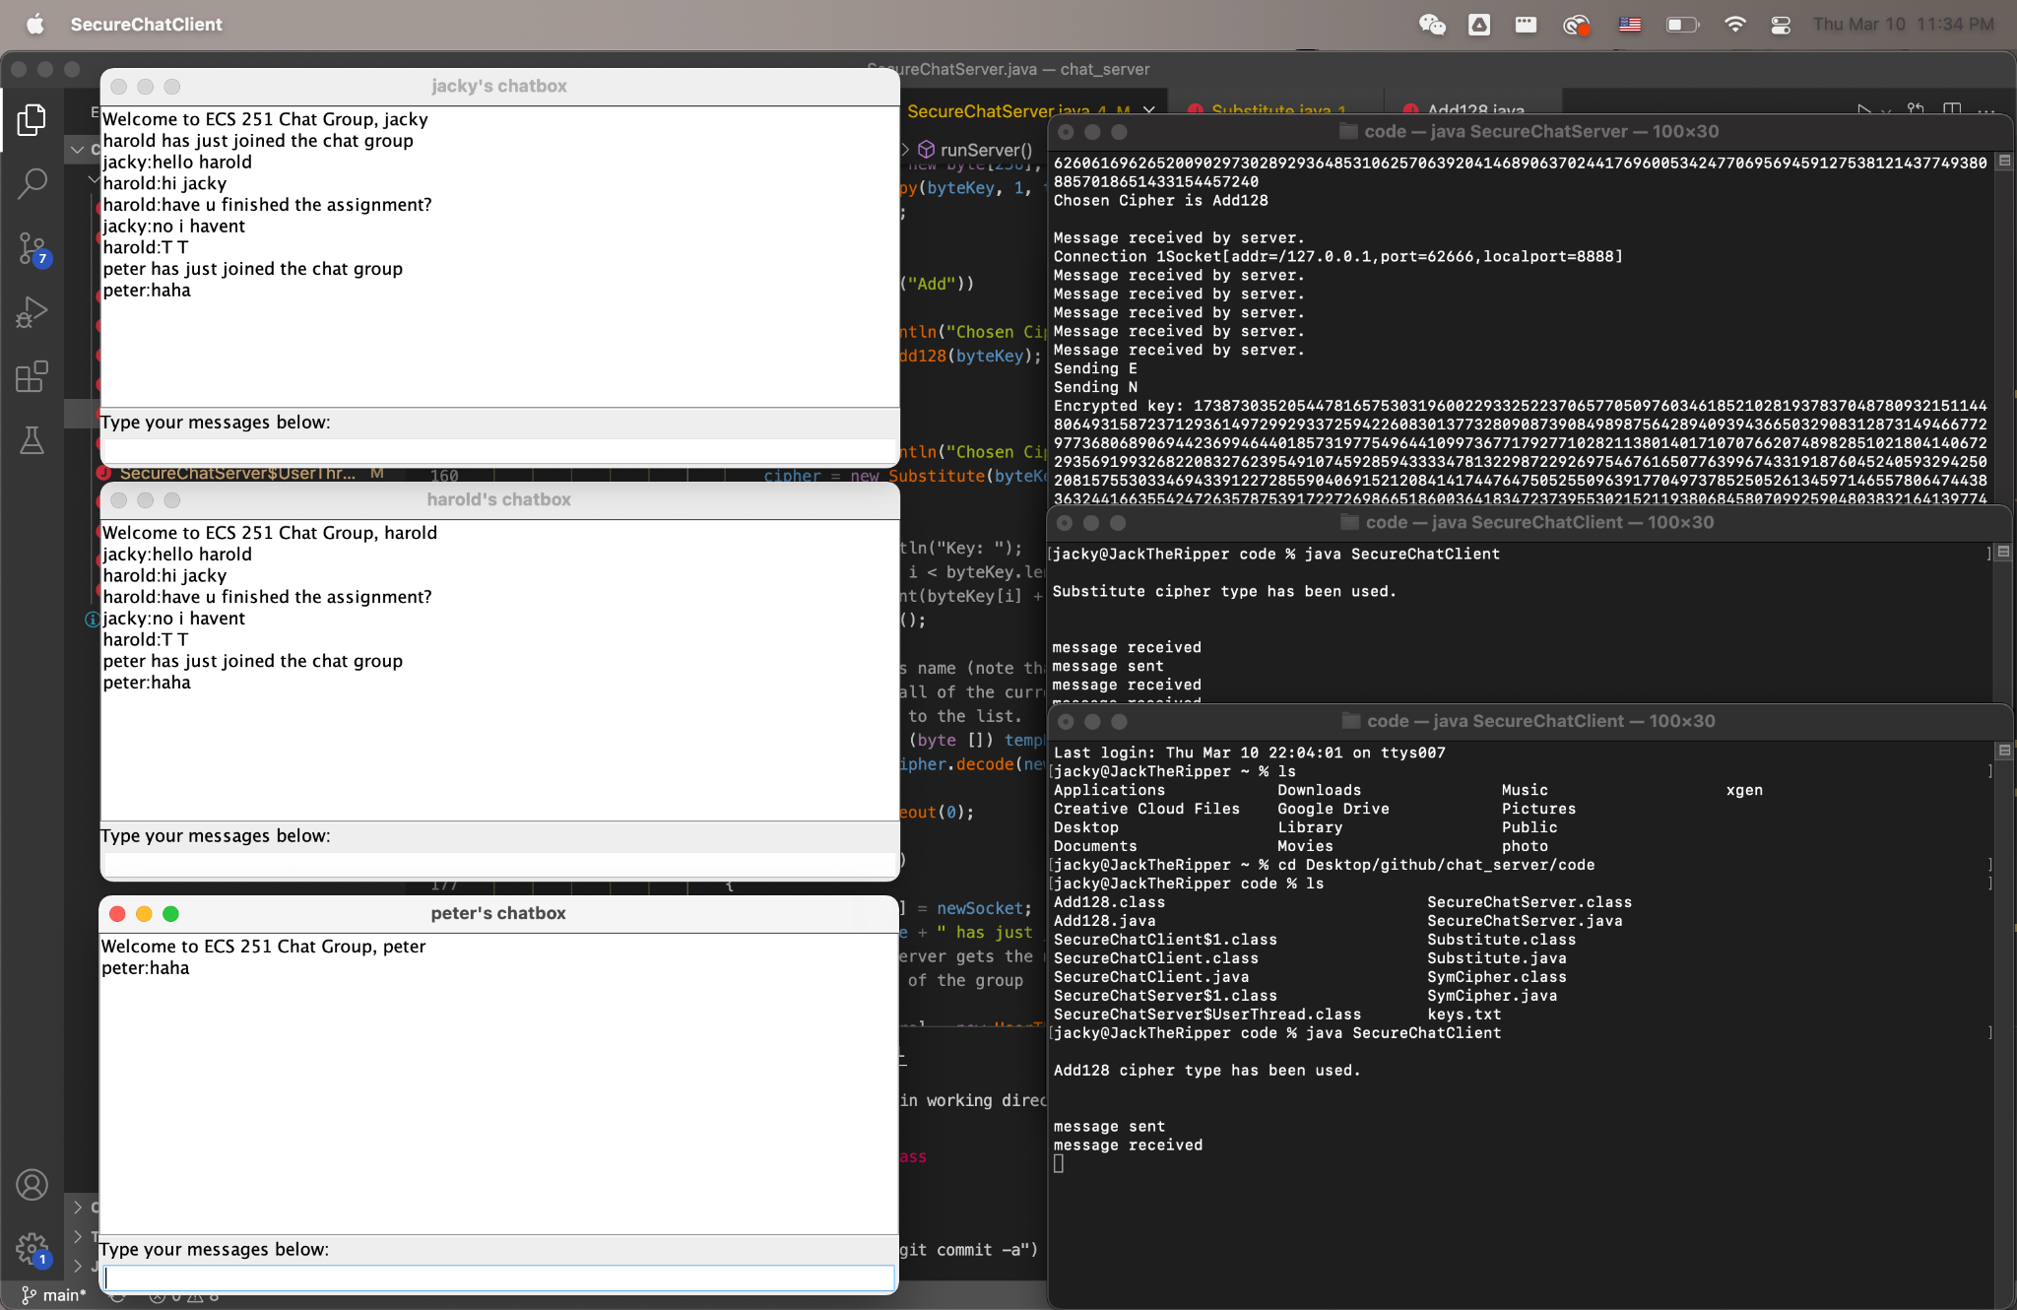

Slide 6
Implementation

Slide 7

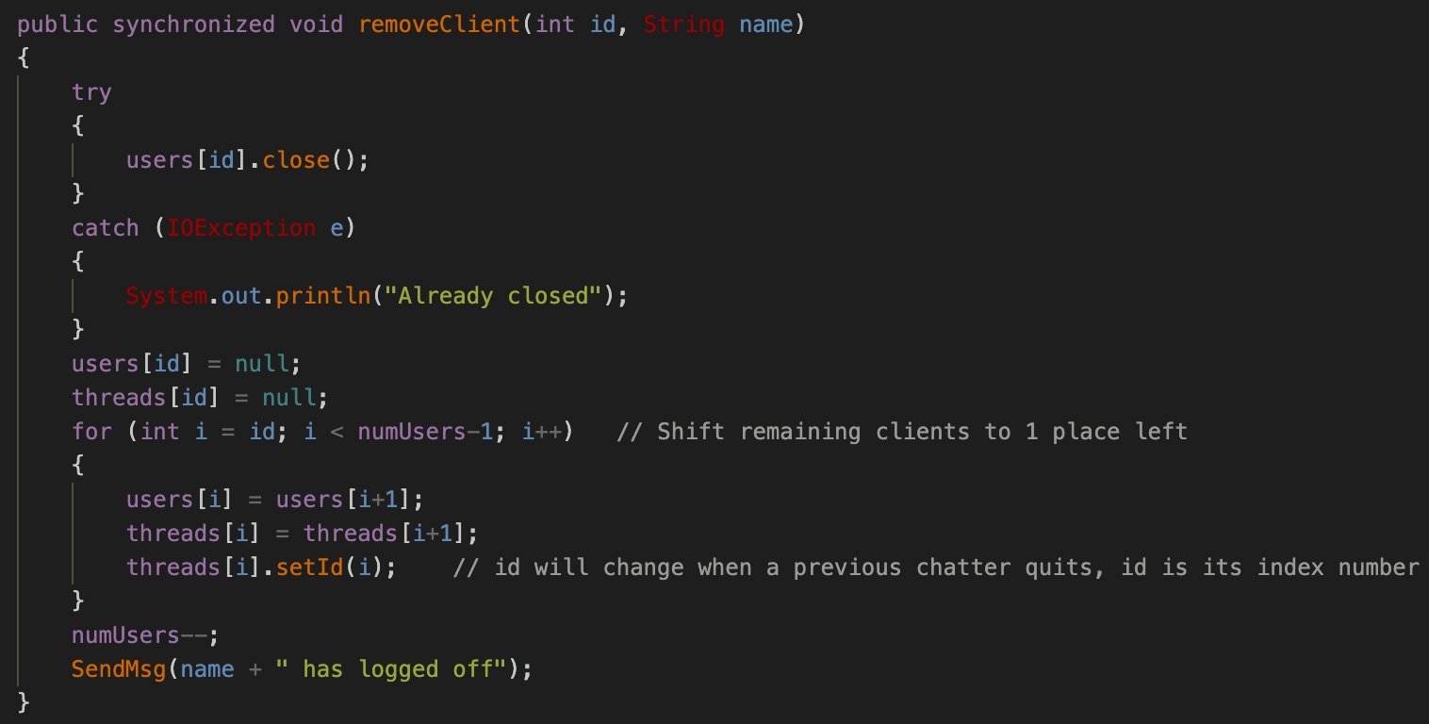
Synchronization
We set each client as a single thread in the server and we use java's built-in synchronized methods to avoid conflict between objects methods.

Slide 8
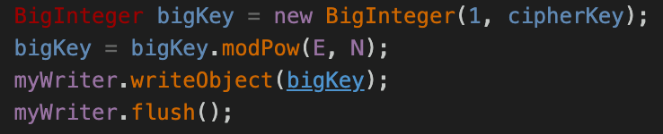
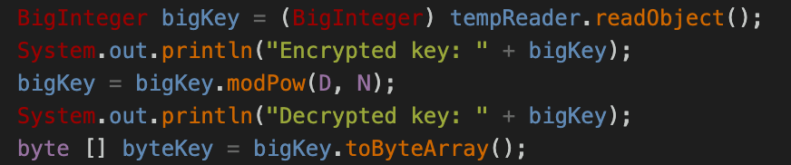
Encryption
We use 2 different ways to encrypt and the user won’t know which encryption methods that are being used. And when a user is trying to connect the server, the client will randomly generate a big integer and send it to the server to generate a cipher for encoding the text messages. By this way, it is a more safe chat server.

Slide 9
Thank you!

